Slide 1
Simple design, clean code
Keep things simple, strive for better life
Fei Yan
05-01-2016

Slide 2
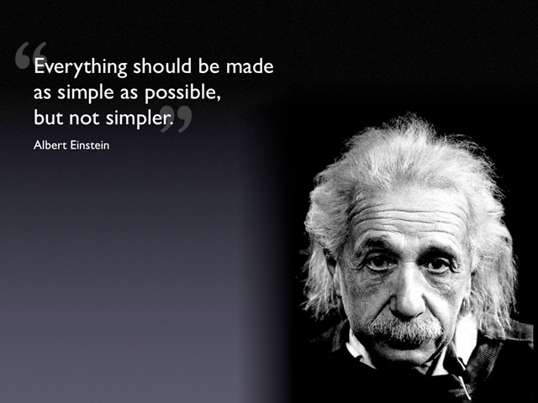
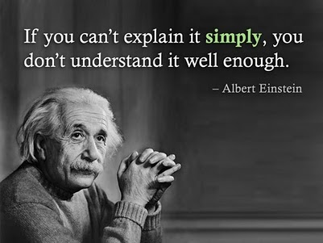
Clean => Simple

Slide 3
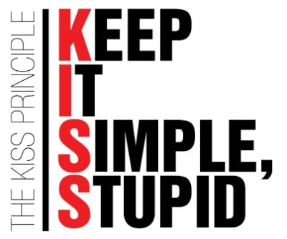
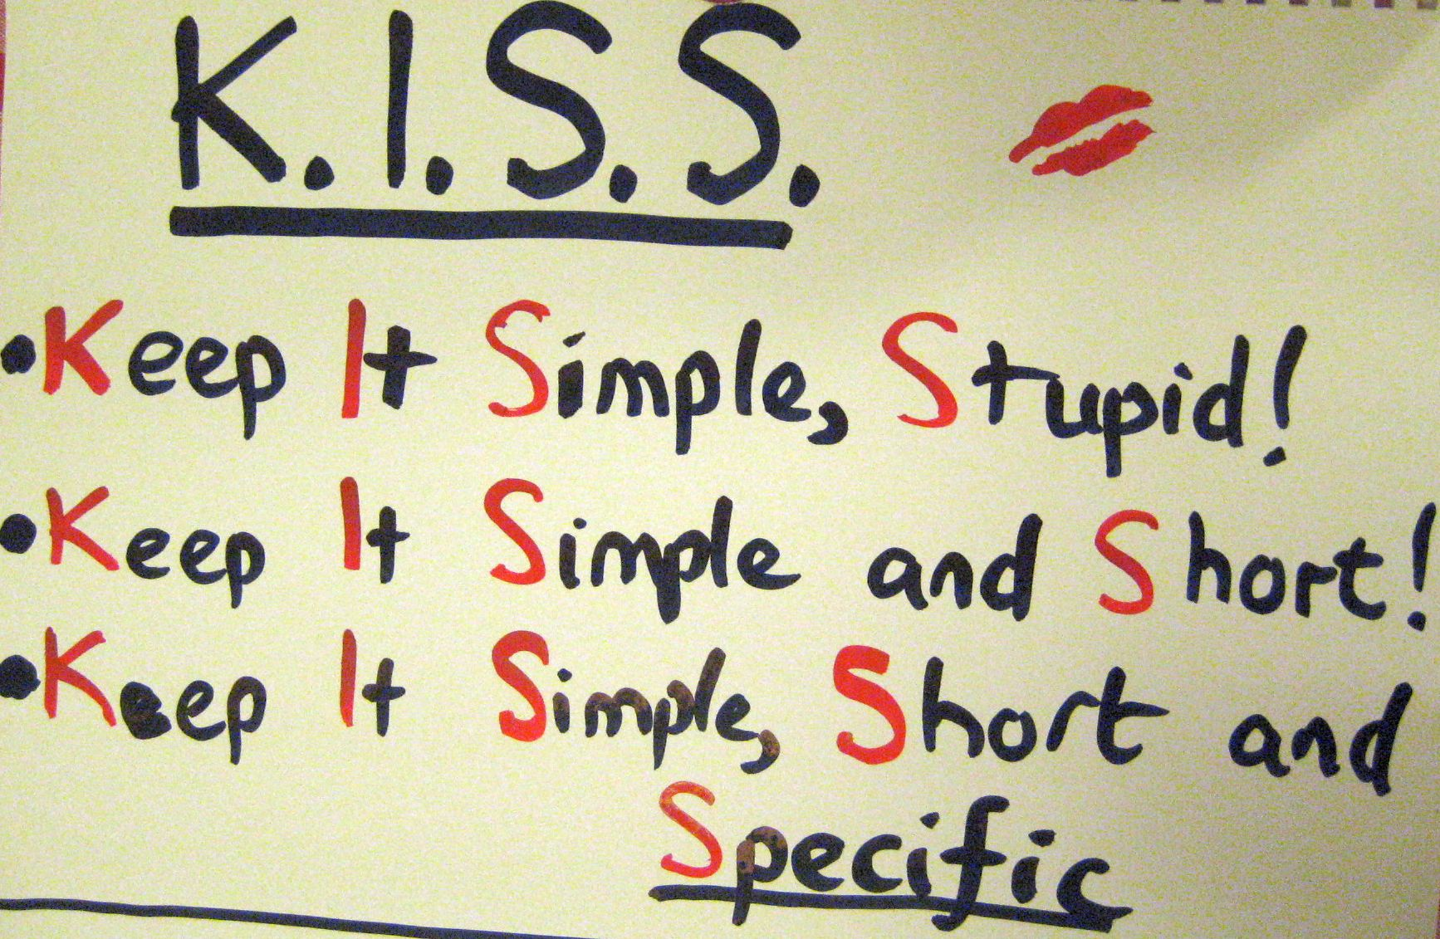
K.I.S.S

Slide 4
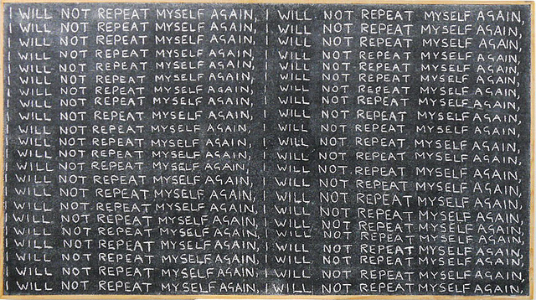
D.R.Y

Slide 5
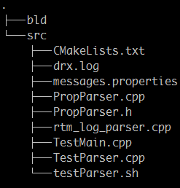
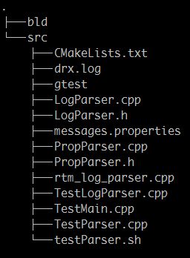
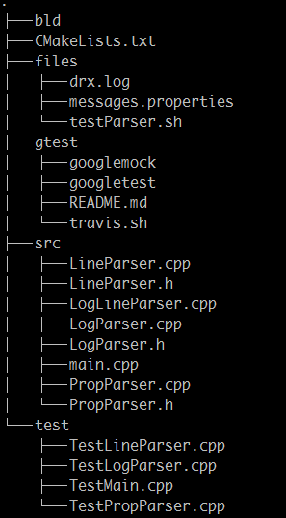
Evolution of structure

Slide 6
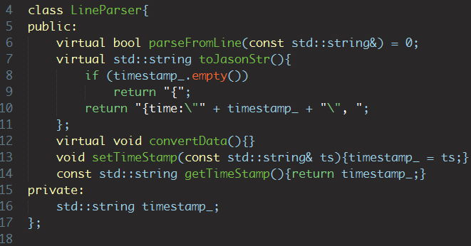
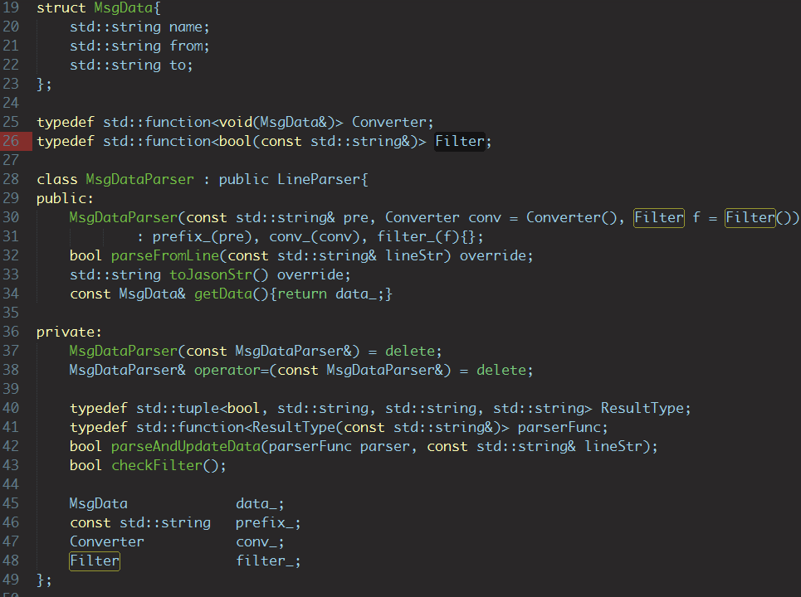

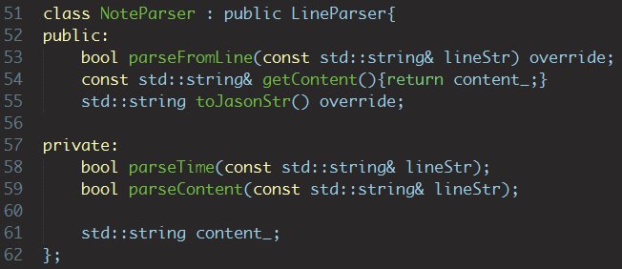
OO abstraction for behaviors

Slide 7
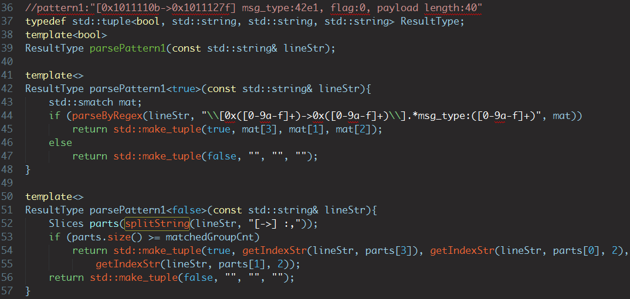
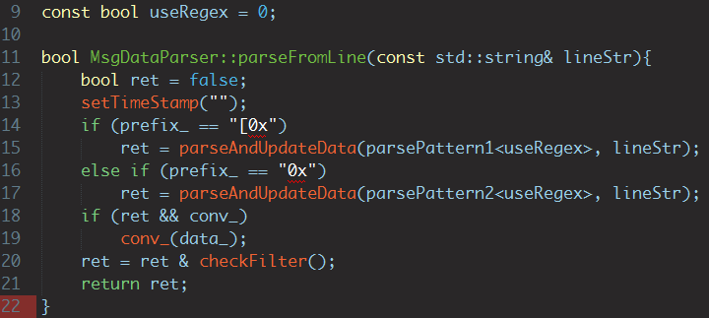
Template specialization for static polymorphism

Slide 8
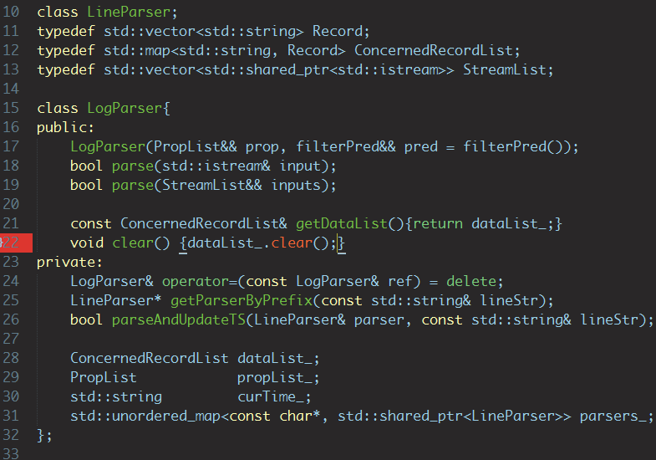
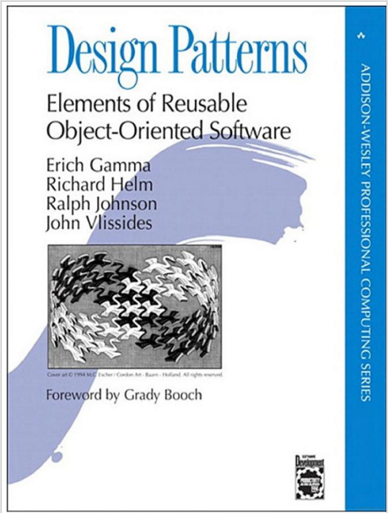
Favor composition over inheritance
Because inheritance exposes a subclass to details of its parent's implementation, it's often said that 'inheritance breaks encapsulation'

Slide 9
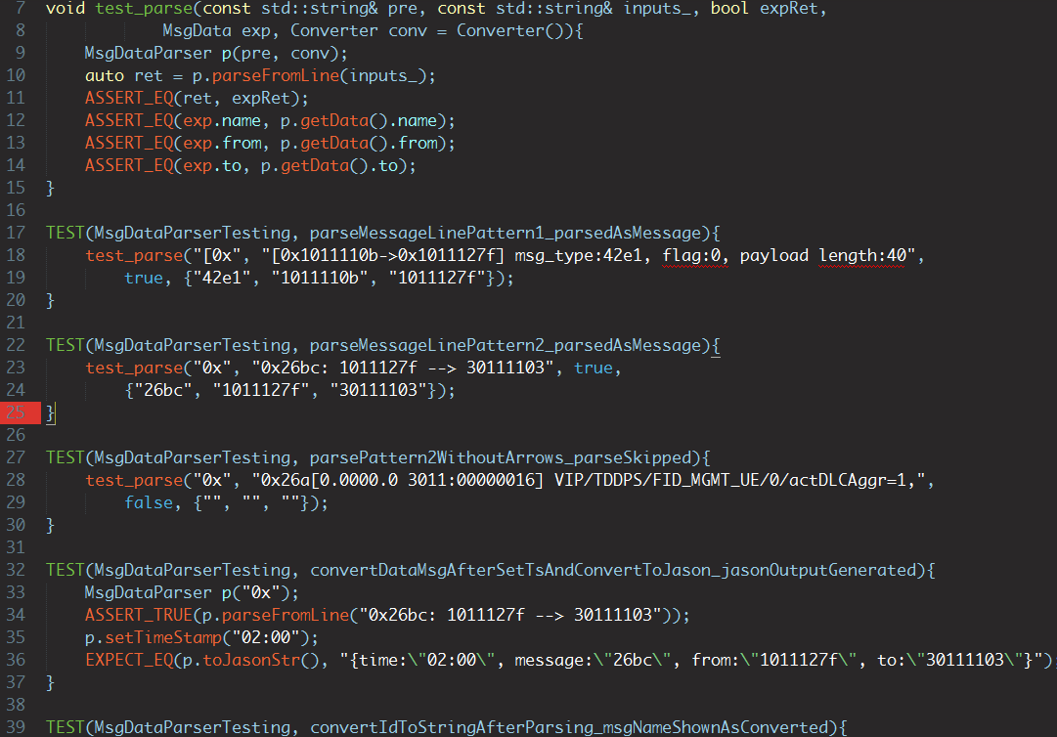

Test public interface intensively

Slide 10
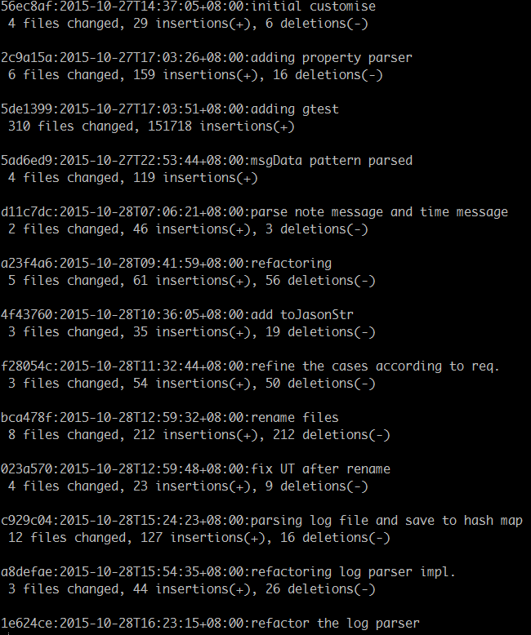
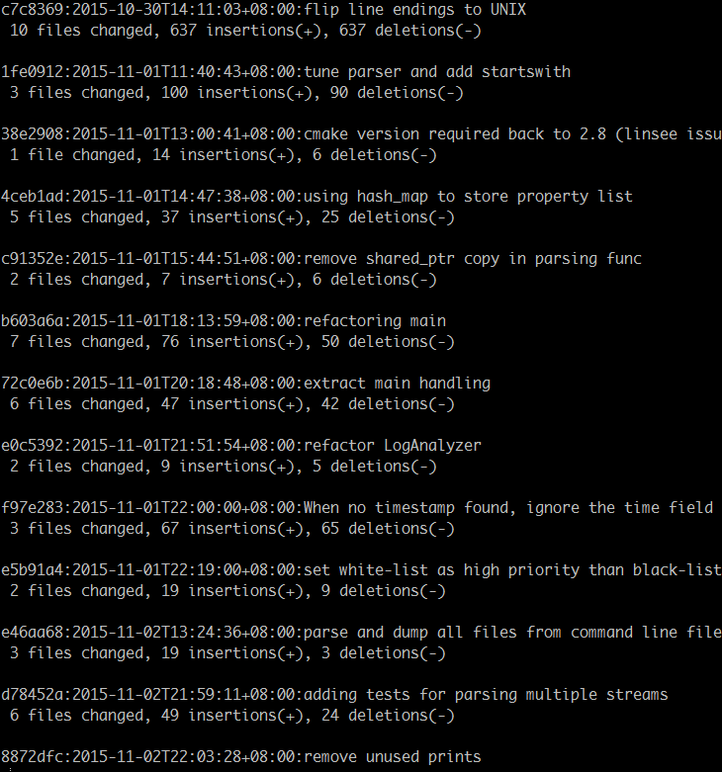
Keep short cycle as possible
Notes:
Command to fetch history of git: git log --pretty=format:%h:%cd:%s --shortstat --date=iso-strict --reverse

Slide 11
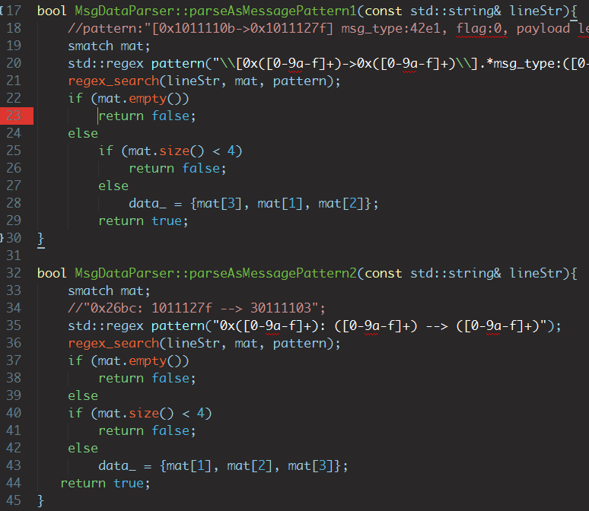
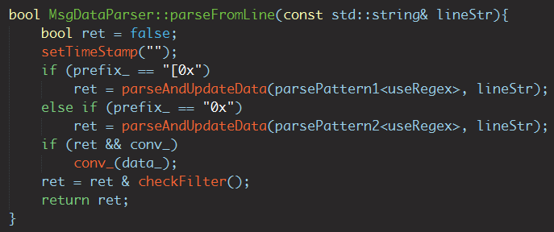
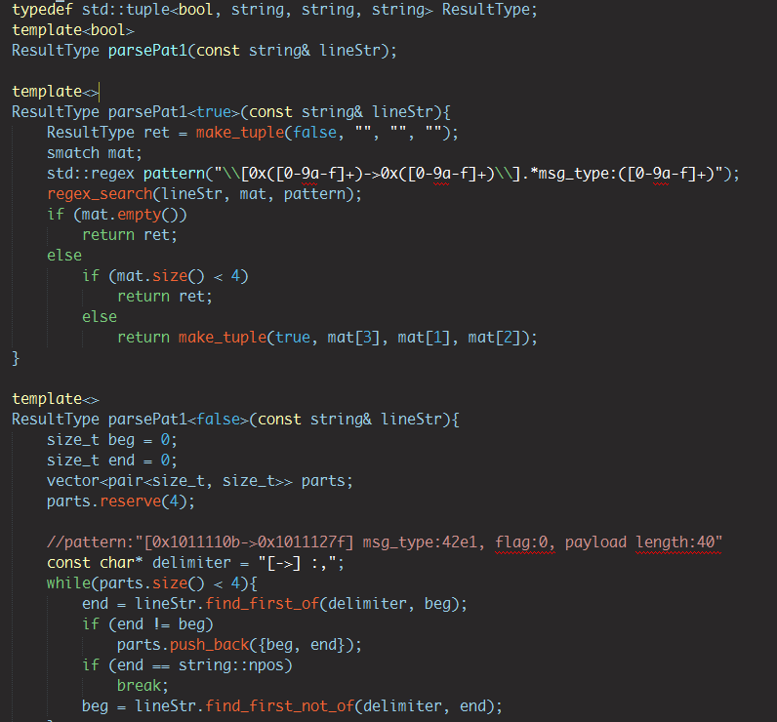
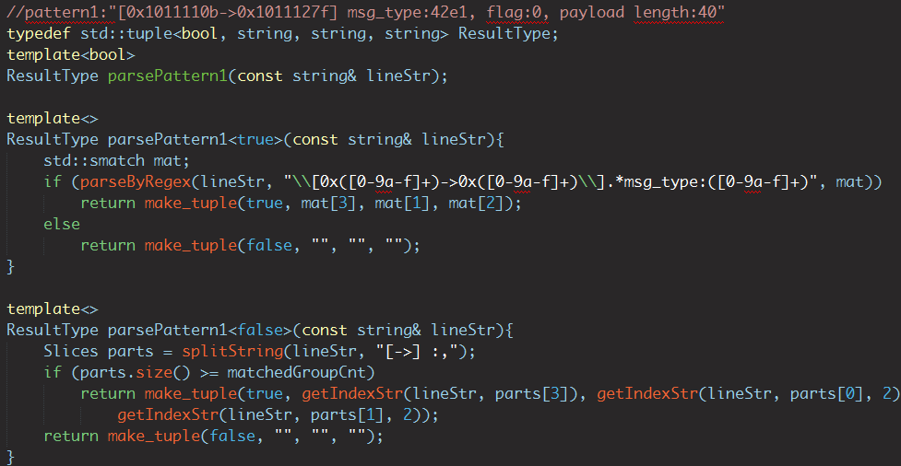
Emergent design/test with discipline
Refactoring continually once enough tests are added against interfaces
Refactoring shall only change the implementation details

Slide 12
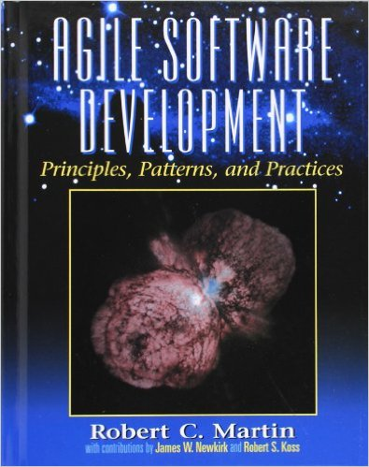
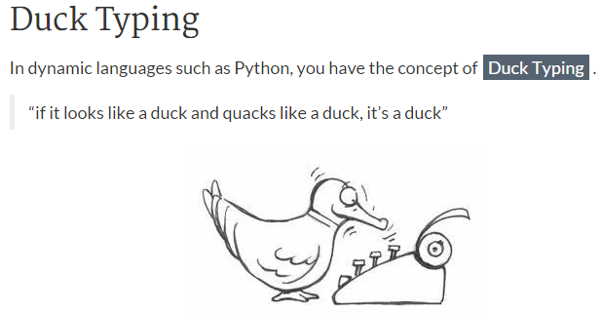
Core principles in large adoption
SOLID principle for OO system
Single responsibility principle
Open closed principle
Liskov substitution principle
Interface Segregation
Dependency Inversion
Porgram to interface, not implementation
Beyond abstract class
Duck typing system
Functions can also be interfaces
Interface is more abstraction of behaviors than names, to some extent

Slide 13
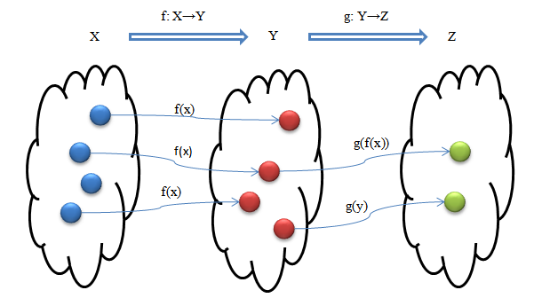

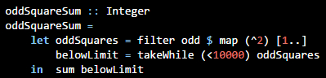
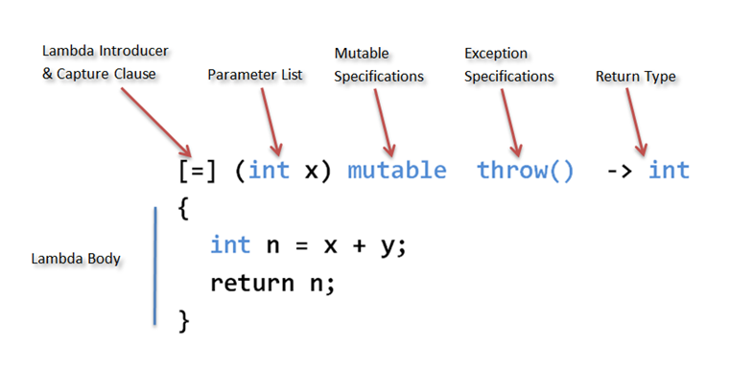
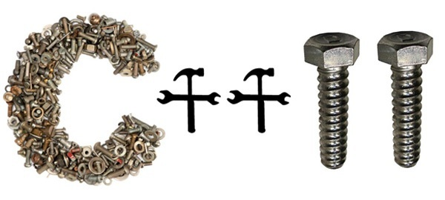
Go functional
Notes:
https://www.schoolofhaskell.com/user/imalsogreg/functional-programming-elevator-pitch

Slide 14
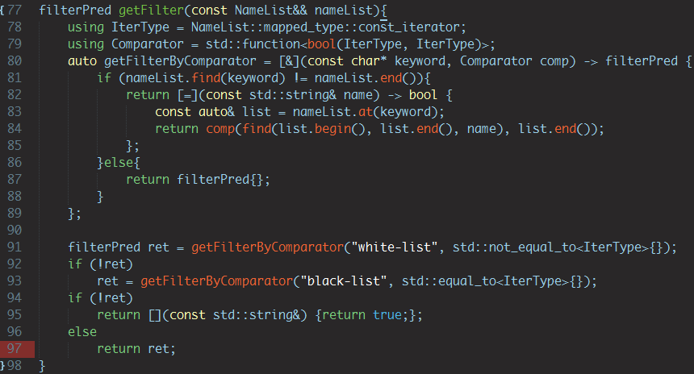
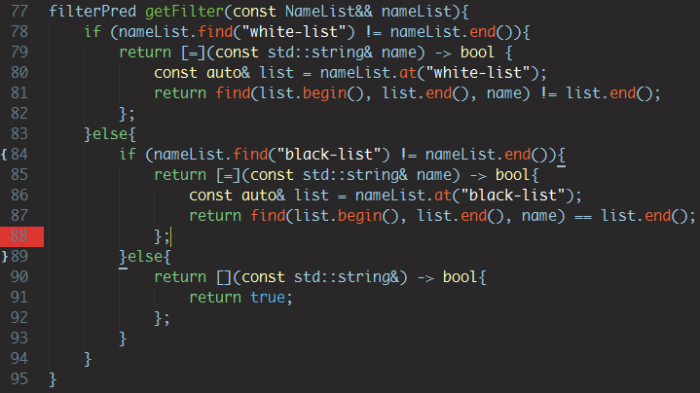
Filters for black/white list
High order functions are better and more general, but hard to construct due to limitation of C++11
Few duplication seems good enough yet and simpler!
Notes:
https://www.schoolofhaskell.com/user/imalsogreg/functional-programming-elevator-pitch

Slide 15
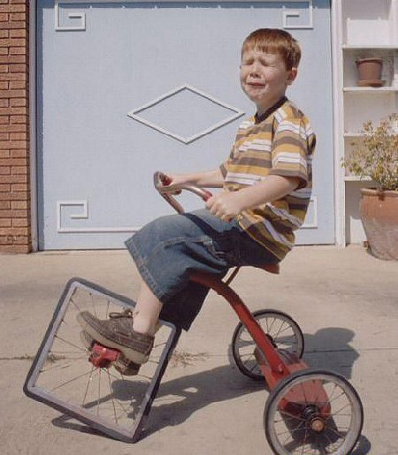
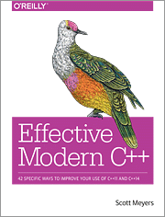
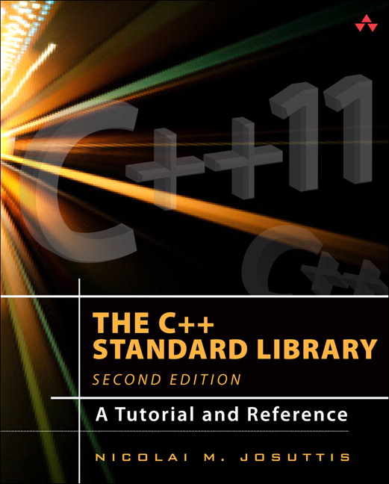
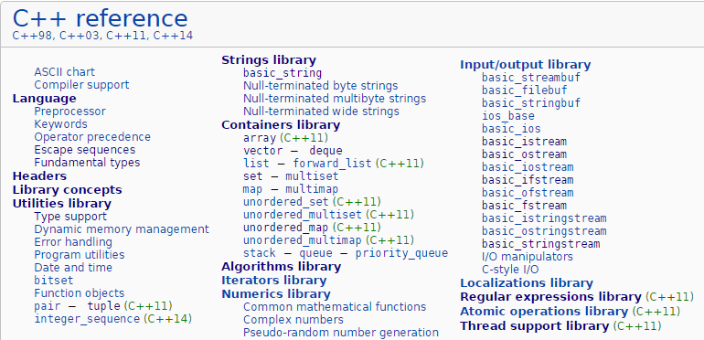
Don’t reinvent the wheels
http://blog.codinghorror.com/dont-reinvent-the-wheel-unless-you-plan-on-learning-more-about-wheels/

Slide 16
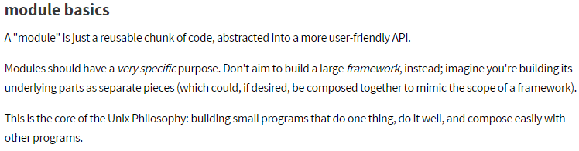
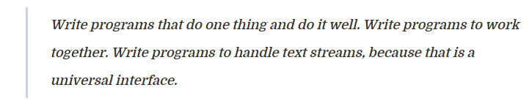
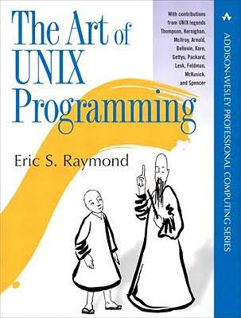
Unix philosophy
Do one thing and do it well – McIlroy
Small and beautiful honors
NPM-module basics
K.I.S.S and 17 rules
By Eric S. Raymond
Extending to various guidelines
Modularity/clarity/separation
Composition/Representation
Lest surprise/Silence
Etc…
Notes:
http://benlakey.com/2015/04/12/unix-philosophy/

Slide 17
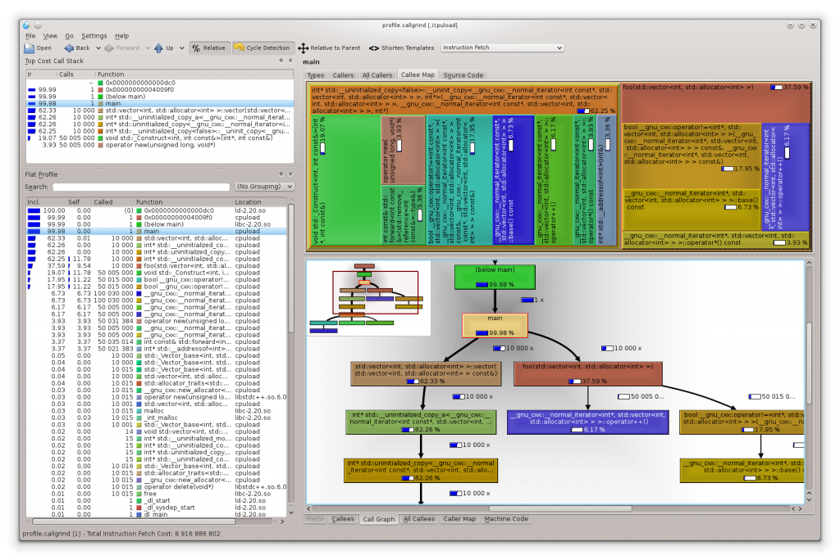
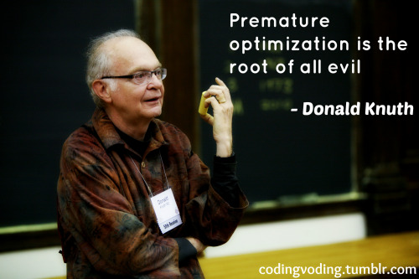
Performance
Not an excuse of being sloppy!
Measure by testing/profiling
Don’t copy large objects!
Make algorithm simple
Select the best trade-offs
Notes:
http://www.joshbarczak.com/blog/?p=580

Slide 18
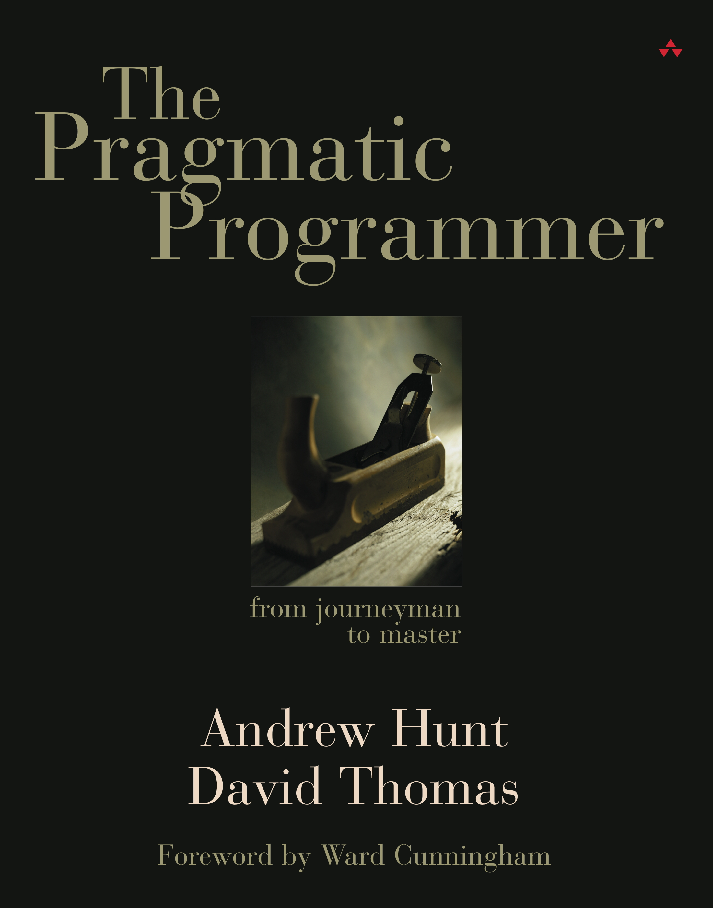
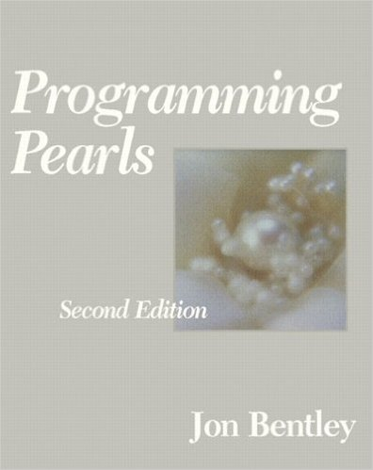
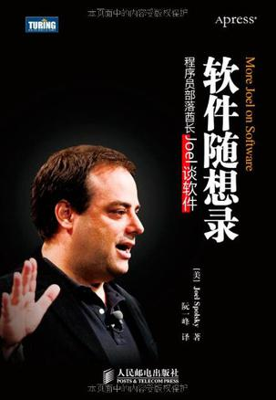

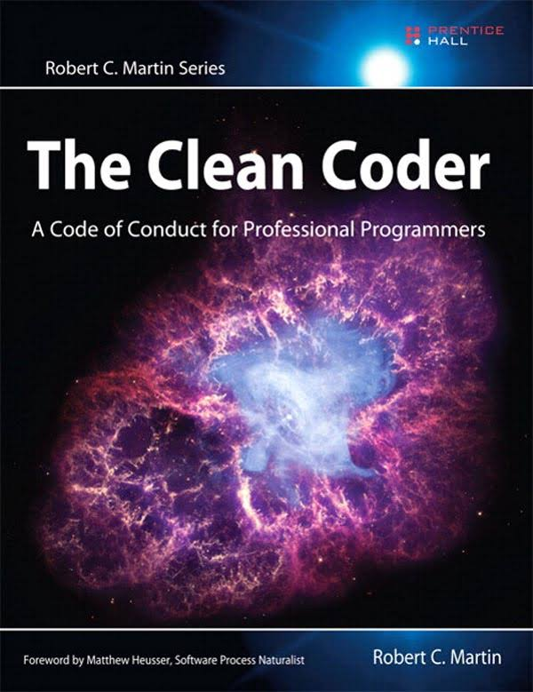
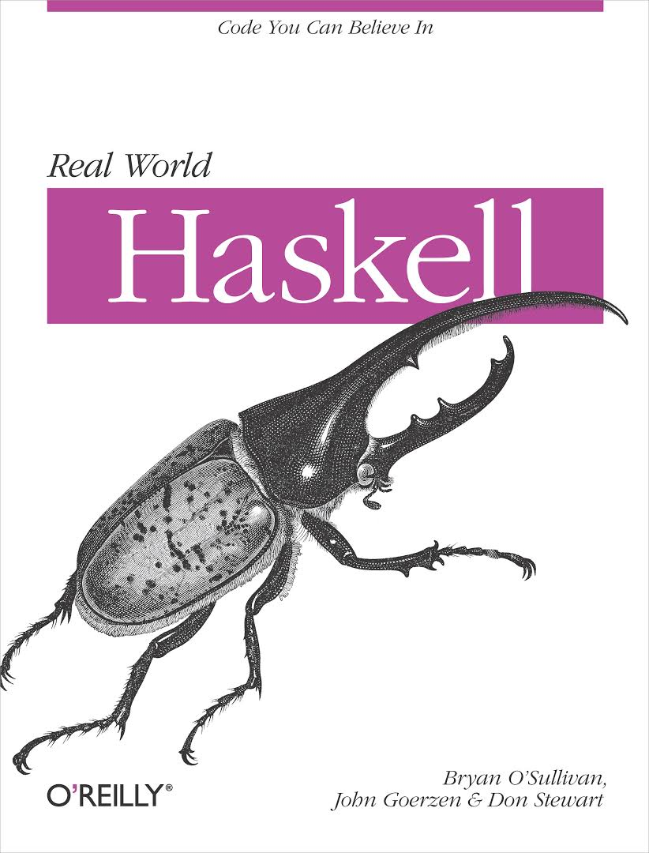
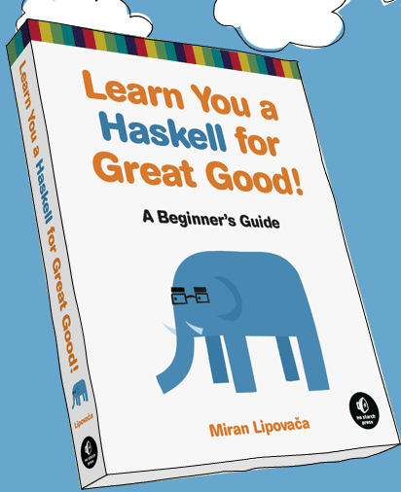
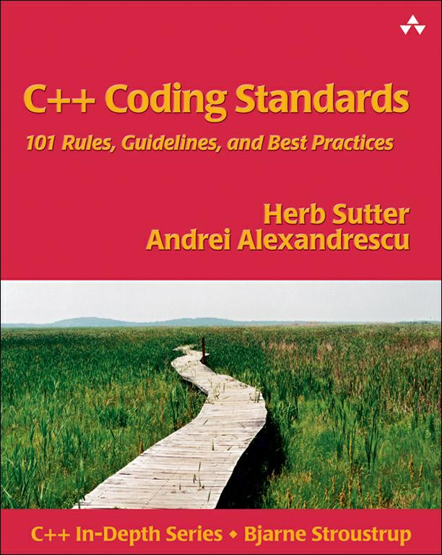
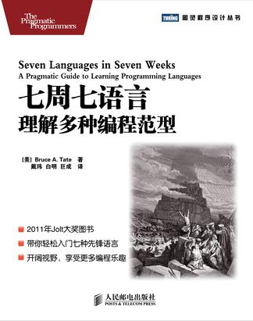
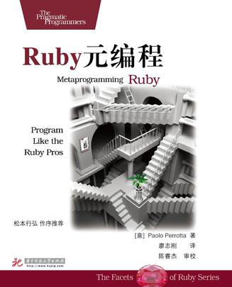
Suggested reading
Notes:
http://benlakey.com/2015/04/12/unix-philosophy/

Slide 19
More references…
Blogs/Videos/Talks
Clean coder blog
Coding Horror by Jeff Atwood
Real world Haskell, on line version
Herb Suter on software development
NDC channel on vimeo – new developers conference
C++ references
MSDN channel9: going native subchannel
FP/Testing/etc
Functors, applicatives and monads in picture
Monads in C++ by Bartosz Milewski
Bandit - human friendly unit testing for C++11
Martin Fowler – Mocks aren’t stubs
Extreme programming
C++ core guidelines
Notes:
http://benlakey.com/2015/04/12/unix-philosophy/

Slide 20

Notes:
http://benlakey.com/2015/04/12/unix-philosophy/

